Slide 1
CUSTOMER CHURN ANALYSIS ABC COMMUNICATIONS LTD.
Business Analytics Project
By
Ibtihaj Shuaib
Data Analytics Intern – AnalystLab Africa
August, 2026

Slide 2
BUSINESS PROBLEM
ABC Communications Ltd. is experiencing customer churn and needs to identify the factors contributing to it so effective customer retention strategies can be developed.

Slide 3
BUSINESS OBJECTIVES
Understand the customer base
Identify customers most likely to churn
Determine the impact of contract type on customer retention
Examine customer tenure and total charges
Analyse internet service, payment methods and churn
Recommend customer retention strategies

Slide 4
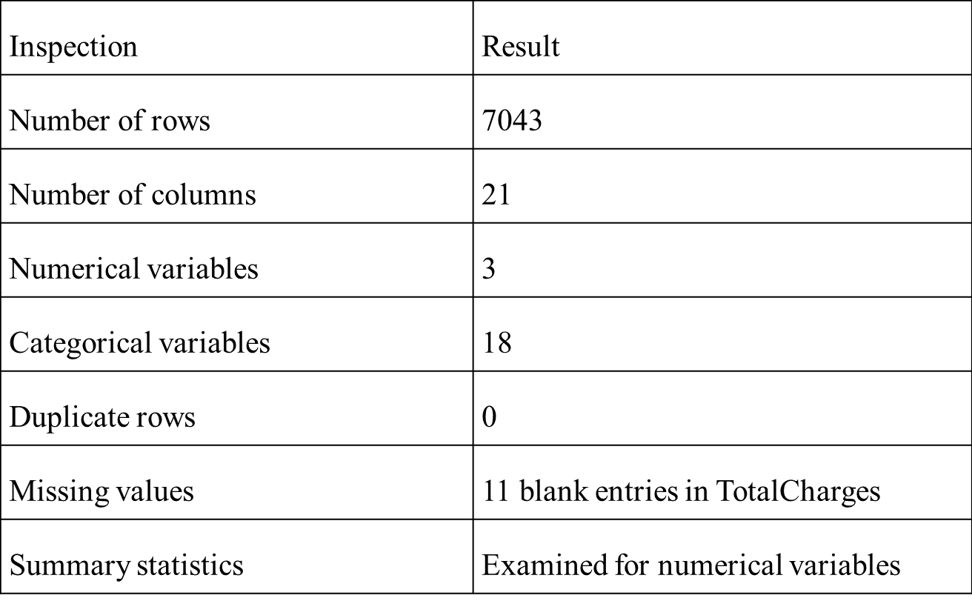
DATASET OVERVIEW
Each row represent a customer and each column represents a customer attribute

Slide 5
OVERALL CUSTOMER CHURN
More than one-quarter of the customer base churned, making customer retention an important business priority.

Slide 6
CHURN BY CUSTOMER SEGMENT
Senior citizen customers had a substantially higher observed churn rate.

Slide 7
CHURN BY CONTRACT TYPE
Month-to-month customers had substantially higher observed churn than customers on longer-term contracts.

Slide 8
CUSTOMER TENURE DISTRIBUTION
Most customers have a shorter tenure, with frequency decreasing as tenure increases.

Slide 9
TENURE CORRELATION ANALYSIS
Tenure has a strong positive correlation with total charges, while its relationship with monthly charges is weak

Slide 10
CHURN BY INTERNET SERVICE & PAYMENT METHOD
Fiber-optic customers and electronic-check users recorded particularly high churn rate and should be investigated further

Slide 11
KEY BUSINESS INSIGHTS
Over one-quarter (26.54%) of customers have churned.
Month-to-month customers have the highest churn at 42.71%.
Senior customers have a higher observed churn rate at 41.68%.
Fiber-optic and electronic-check customers show particularly high churn.
Tenure has a strong positive associated with Total Charges (r = 0.826).

Slide 12
BUSINESS RISKS & OPPORTUNITIES
Risks
Continued customer and revenue loss
Customer Base Instability
Potential loss of valuable long-term customers
Opportunities
Convert month-to-month customers to longer-term contracts
Improve the fiber-optic customer experience
Develop targeted retention programmes for high risk segment

Slide 13
BUSINESS RECOMMENDATIONS
Encourage longer-term contracts through incentives and loyalty benefits.
Target high-risk customer segments with personalized retention strategies.
Investigate fiber-optic churn and address potential service or pricing issues.
Review the electronic-check payment experience.
Monitor churn regularly using customer data.

Slide 14
CONCLUSION
The analysis identified several customer segments with substantially higher observed churn, particularly month-to-month customers, senior customers, fiber-optic users and electronic-check users
Targeted retention strategies focused on these segments could help ABC Communications Ltd. reduce churn and protect revenue.

Slide 15
THANK YOU

